Slide 1

A Research on the Factors Affecting E-learning Acceptance of College Students
大学生电子化学习接受程度影响因素调查研究
Running Title: Factors affecting e-learning acceptance
Student: Han Haochen
Supervisor: Zhang Mei
Assistant: Zeng Yuting
March. 22, 2023

Slide 2
Catalog
1 Background and Significance
2 Research Methods
3 Results and Implications

Slide 3


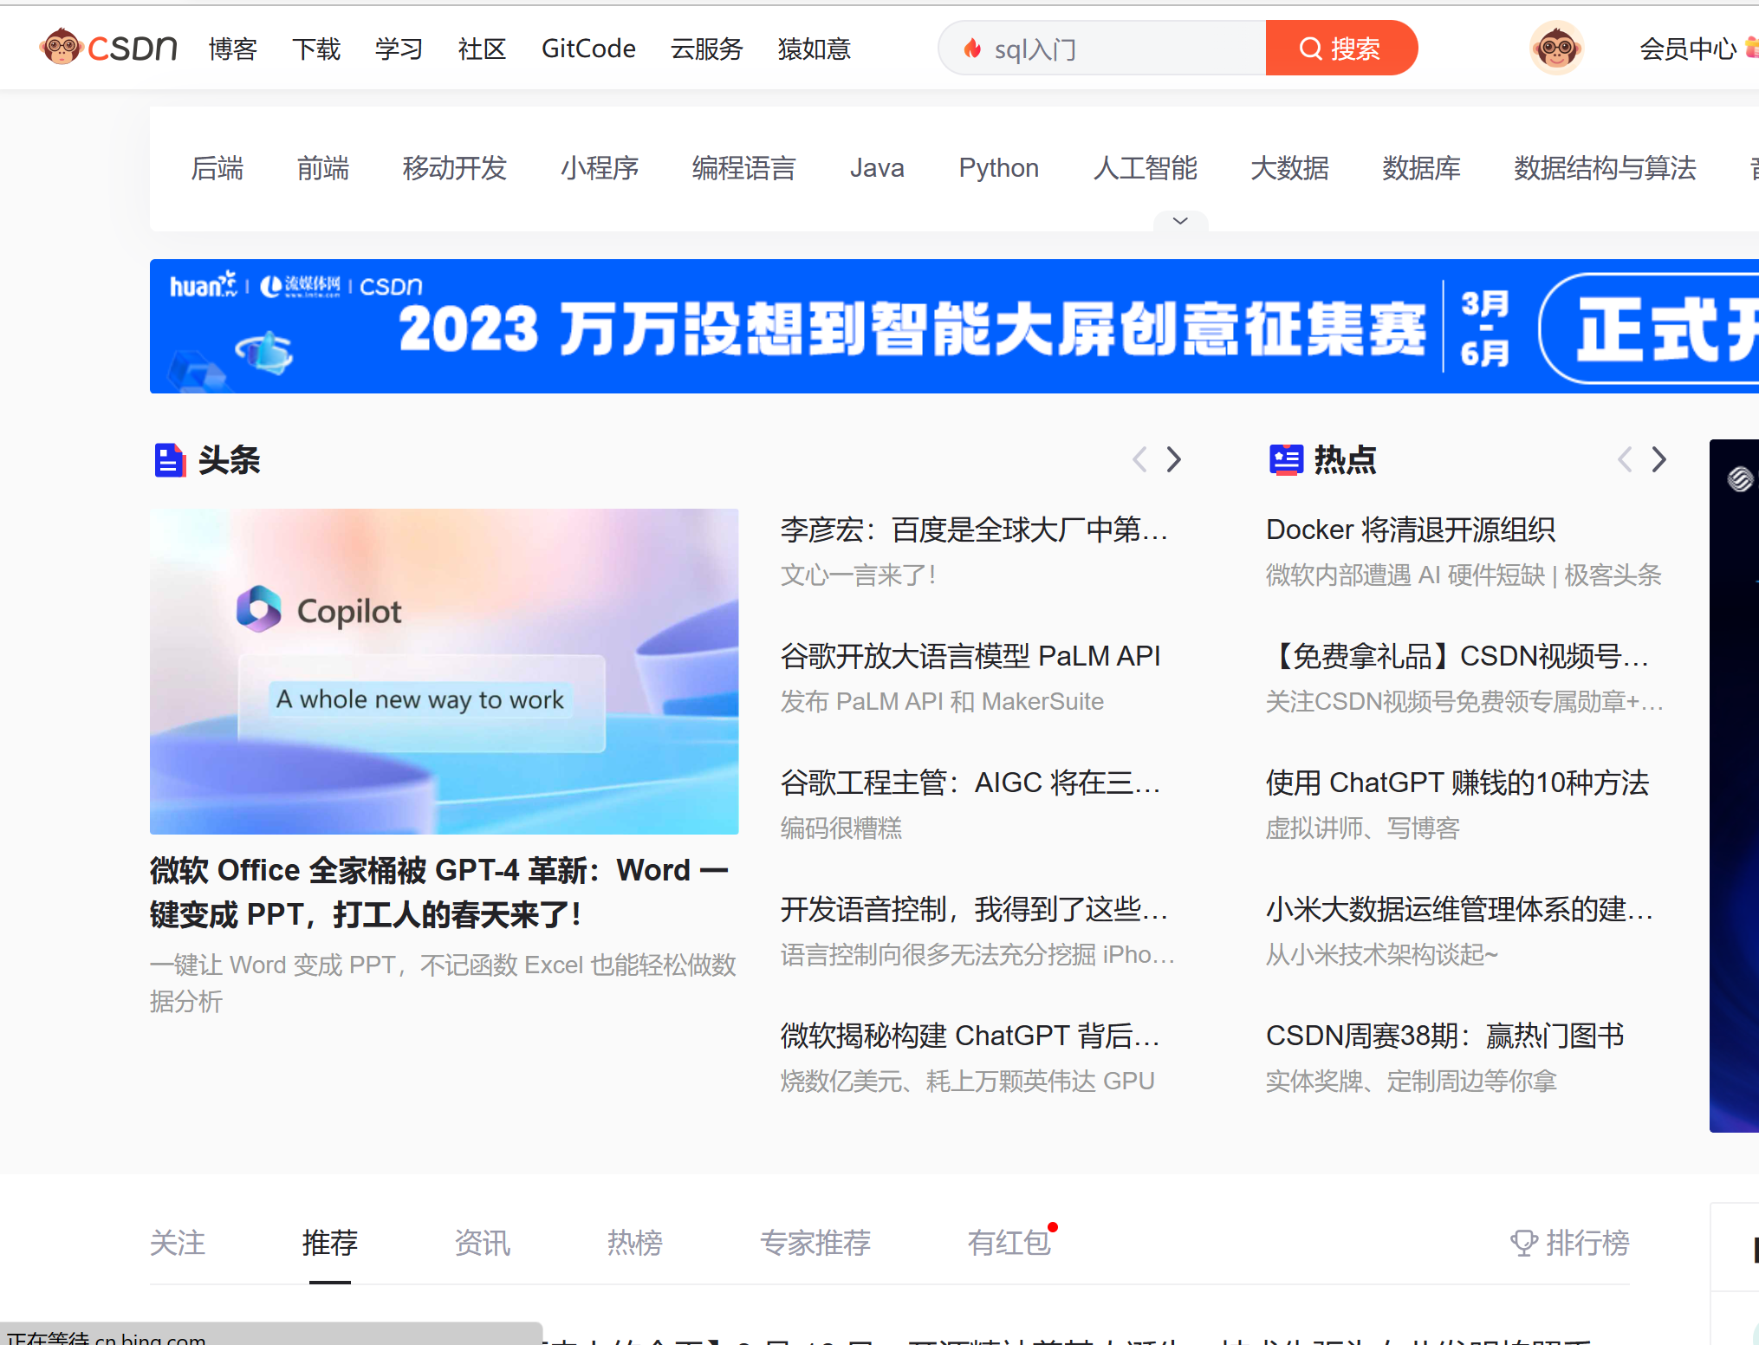
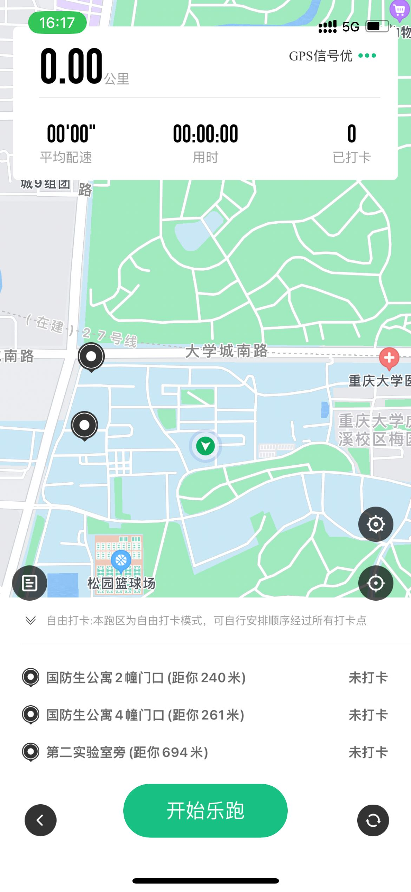
Factors affecting e-learning acceptance
01
Background and Significance
Widely spread e-learning and higher requirement

Slide 4


Factors affecting e-learning acceptance
01
Background and Significance
Widely spread e-learning and higher requirement
Students with different e-learning acceptance

Slide 5
Factors affecting e-learning acceptance
01
Background and Significance
Widely spread e-learning and higher requirement
Students with different e-learning acceptance
What factors will affect the acceptance of e-learning and how much they will affect it
Research Question

Slide 6
Factors affecting e-learning acceptance
02
Research Methods
Key Index:
Factors affecting e-learning acceptance
How to determine the index?
How to quantify the index?
How to analyze the index?

Slide 7
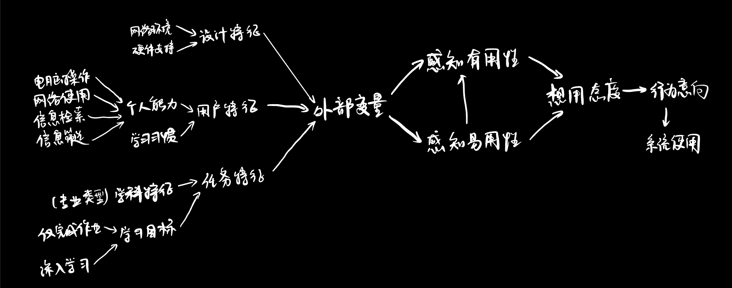
Factors affecting e-learning acceptance
02
TAM: Determine the index
TAM
(Technology Acceptance Module):
Perceived usefulness:
The degree to which a person feels that using a specific system has improved his performance
Perceived ease of use:
The degree to which a person feels how easy to use a specific system

Slide 8
Factors affecting e-learning acceptance
02
TAM: Determine the index
Perceived usefulness:
The degree to which a person feels that using a specific system has improved his performance
Perceived ease of use:
The degree to which a person feels how easy to use a specific system
Minimum variables (focus on)

Slide 9

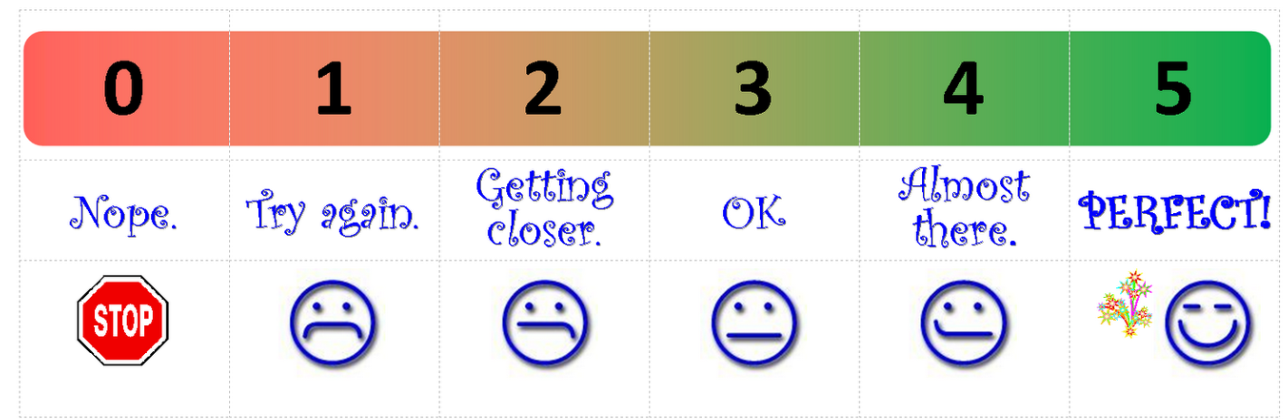
Factors affecting e-learning acceptance
02
Likert: Quantify the index
Instrument: Questionnaire
Participants: CQU students
Minimum variables: 硬件支持 网络环境 个人能力 学习习惯 学科特征 学习目标 ……
Detailed in questionnaire in the form of questions
Method: Likert scale

Slide 10

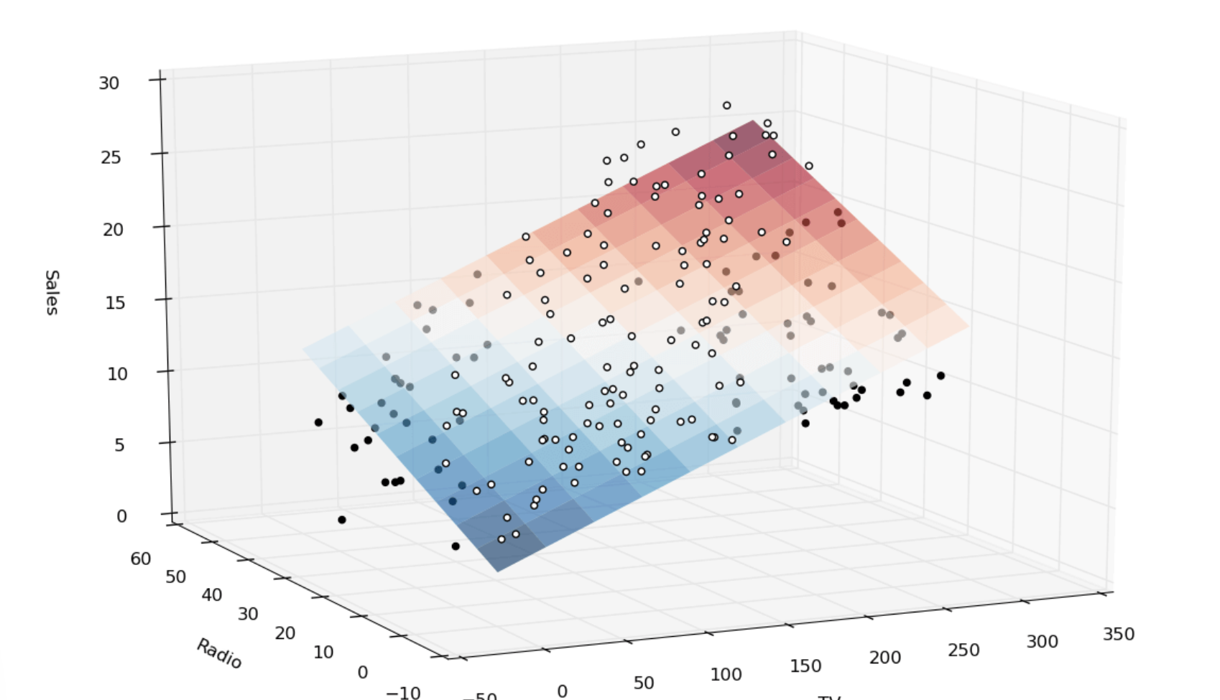
Factors affecting e-learning acceptance
02
Analyze the index
Points collected from questionnaire
Principal component analysis Multiple linear regression

Slide 11
Factors affecting e-learning acceptance
02
Research Methods
Key Index:
Factors affecting e-learning acceptance
How to determine the index?
TAM module
How to quantify the index?
Likert scale
How to analyze the index?
Principal component analysis & Multiple linear regression

Slide 12
Factors affecting e-learning acceptance
03
Results and Implications
Constructive suggestions for:
students schools e-platforms …
Promote the popularization of e-learning!

Slide 13
Thanks for listening!
A Research on the Factors Affecting E-learning Acceptance of College Students
Student: Han Haochen
Supervisor: Zhang Mei
Assistant: Zeng Yuting
March. 22, 2023

Slide 14







Slide 15
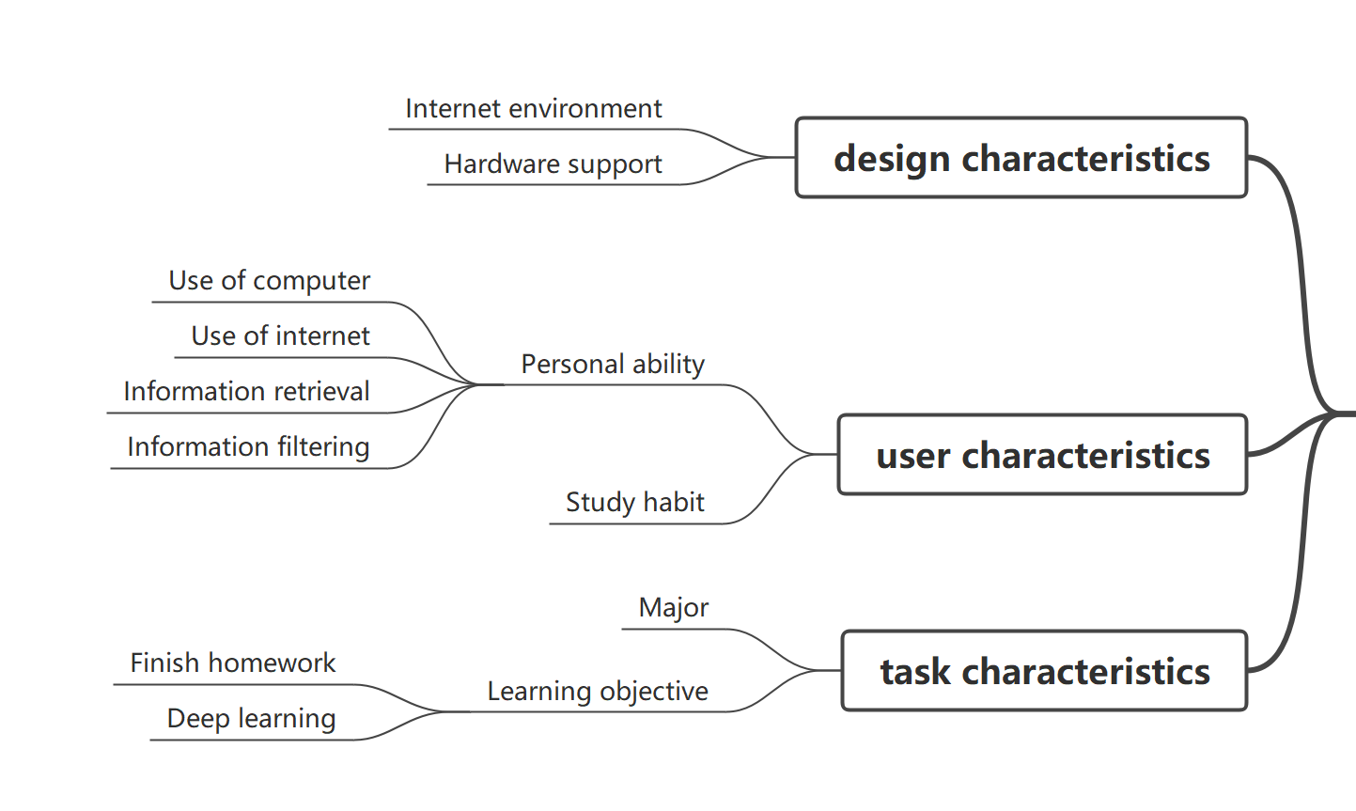
Perceived Usefulness (U)
External Variables
Attitude toward Using (A)
Behavioral Intention to Use (BI)
Actual System Use
Perceived Ease of Use (E)

